Slide 1
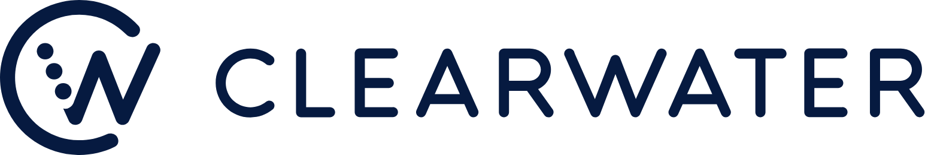
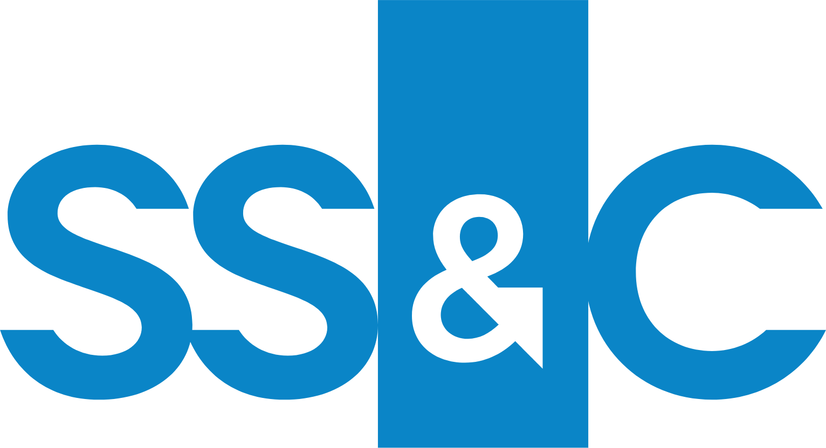




CWAN is a sticky challenger whose lead is narrowing
SimCorp's 18% ARR growth now edges CWAN's 17.0% organic ARR growth, NRR fell to 108%, and the sale drew no strategic bid
Company | Overlapping line | Ownership / listing | FY24 $M | FY24 YoY | Q3'25 YoY | ARR YoY⁴ | FY24 margin
 | Total revenue | NYSE: CWAN (target) | 451.8 | 22.7% | 77.1%¹ | 17.0% | 32.2% adj. EBITDA
 | Total revenue (one segment) | Nasdaq: SSNC; CEO ~14.0% | 5,882.0 | 6.9% | 7.0% | – | 22.8% operating
 | Aladdin tech services | NYSE: BLK; captive unit | 1,603.0 | 7.9% | 27.8%² | – | Not disclosed
 | Capital Market Solutions | NYSE: FIS | 2,979.0 | 7.7% | 7.3% | – | 51.0% adj. EBITDA
 | Alpha front office software | NYSE: STT | 639.0 | 10.2% | 14.4% | ~13% | Not disclosed
 | Software Solutions ARR (€M)³ | Deutsche Börse ($4.2bn) | 608.0 | 17.0% | 10% | 18% | 24.0% NTM EBITDA
Moat scorecard, Compound judgment (average 3.0 of 5)
What would change the thesis
Up: NRR back to 115% once new pricing starts 1 Jan 2026
Up: strategic buyers bid at exit (sale process: 52 potential acquirors excl. Consortium; no strategic bid)
Down: Aladdin or SimCorp win US insurers; GRR below 98%
Down: SimCorp ARR keeps outgrowing CWAN organic ARR
Moat | Score | For | Against
Single instance | 4 / 5 | Win rate 80% | SimCorp ARR 18% vs CWAN 17.0%
Net retention (NRR) | 2 / 5 | NRR 116% at Q4'24 | 108% at Q3'25, (8.0)pts
Switching costs | 4 / 5 | GRR 98% incl. acquisitions | Enfusion churn 6.0%; 30-day exit
Insurer / AM base | 3 / 5 | 31% NA insurer penetration | Aladdin powers over 100 insurers
Data and AI edge | 2 / 5 | Over 800 AI agents in use | Management cited AI as a risk
¹ Incl. Enfusion, Beacon from Apr-25. ² Incl. Preqin from Mar-25; 12.0% ex-Preqin. ³ Q3'25 YoY: software net revenue; margin: NTM EBITDA at 2023 deal. ⁴ CWAN organic; SimCorp constant currency.
Source: CWAN 10-K FY2024, Q3'25 earnings release and 2025 earnings calls; SS&C, BlackRock, FIS and State Street FY2024 10-Ks, Q3'25 10-Qs and 2025 earnings calls; Deutsche Börse 2025 earnings calls; Enfusion merger prospectus; DEFM14A; J.P. Morgan board materials (29 Oct 2025); Compound moat analysis. As of the 20 Dec 2025 signing.

